Slide 1
FOODPANTRY DB TEST DATA

Slide 2
Creating the Database -
SHOW DATABASES;
CREATE DATABASE FOODPANTRY;
USE FOODPANTRY;
SHOW TABLES;

Slide 3
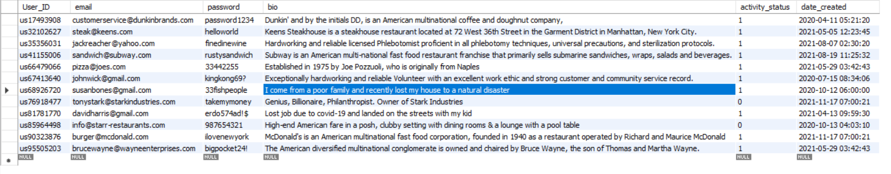
USERS TABLE
create table USERS(User_ID varchar(10) NOT NULL, email varchar(32) NOT NULL, password varchar(15) NOT NULL,
bio varchar(150), activity_status boolean NOT NULL, date_created timestamp NOT NULL); ALTER TABLE USERS ADD CONSTRAINT PK_USERS PRIMARY KEY (User_id);

Slide 4
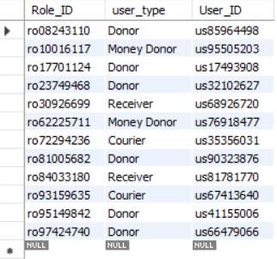
ROLES TABLE
create table ROLES( Role_ID varchar(10) NOT NULL, user_type varchar(20) NOT NULL, User_ID varchar(10) NOT NULL); ALTER TABLE ROLES ADD CONSTRAINT PK_ROLES PRIMARY KEY (Role_id);
ALTER TABLE ROLES ADD CONSTRAINT fk_ROLES FOREIGN KEY (User_ID) REFERENCES USERS(User_ID);

Slide 5
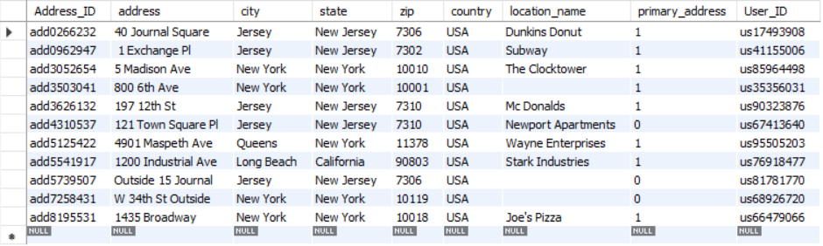
ADDRESS TABLE
create table ADDRESS(Address_ID varchar(10) NOT NULL, address varchar(60) NOT NULL, city varchar(20) NOT NULL, state varchar(20) NOT NULL, zip INTEGER NOT NULL, country varchar(20) NOT NULL, location_name varchar(30) NOT NULL, primary_address boolean NOT NULL,
User_ID varchar(10) NOT NULL);
ALTER TABLE ADDRESS ADD CONSTRAINT PK_ADDRESS PRIMARY KEY (Address_id);
ALTER TABLE ADDRESS ADD CONSTRAINT fk_ADDRESS FOREIGN KEY (User_ID) REFERENCES USERS(User_ID);

Slide 6

MONEY DONATION TABLE
create table MONEY_DONATION( Money_Order_ID varchar(15) NOT NULL, payment_type varchar(10) NOT NULL, amount FLOAT NOT NULL, date_of_donation DATETIME NOT NULL, date_processed_by DATETIME NOT NULL, User_ID varchar(10) NOT NULL); ALTER TABLE MONEY_DONATION ADD CONSTRAINT PK_MONEY_DONATION PRIMARY KEY (Money_Order_id);
ALTER TABLE MONEY_DONATION ADD CONSTRAINT fk_MONEY_DONATION FOREIGN KEY (User_ID) REFERENCES USERS(User_ID);

Slide 7
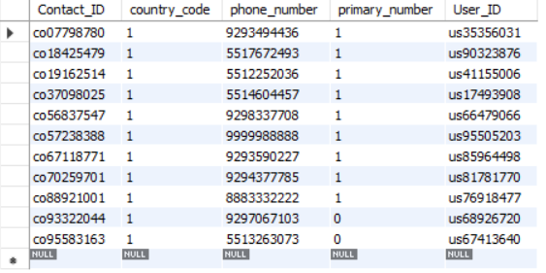
CONTACT TABLE
create table CONTACT(Contact_ID varchar(10) NOT NULL, country_code INTEGER NOT NULL, phone_number varchar(10) NOT NULL,
primary_number boolean NOT NULL, User_ID varchar(10) NOT NULL); ALTER TABLE CONTACT ADD CONSTRAINT PK_CONTACT PRIMARY KEY (Contact_id);
ALTER TABLE CONTACT ADD CONSTRAINT fk_CONTACT FOREIGN KEY (User_ID) REFERENCES USERS(User_ID);

Slide 8
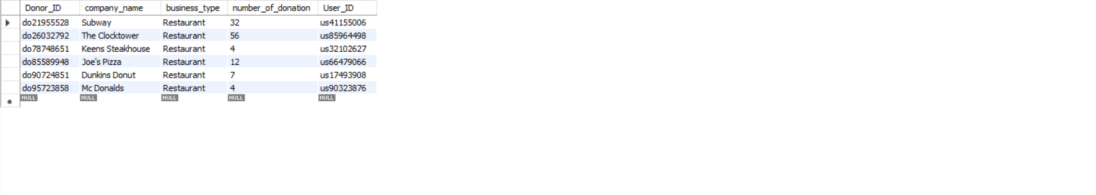
DONOR TABLE
create table DONOR(Donor_ID varchar(10) NOT NULL, company_name varchar(30) NOT NULL, business_type varchar(20) NOT NULL, number_of_donation INTEGER NOT NULL, User_ID varchar(10) NOT NULL); ALTER TABLE DONOR ADD CONSTRAINT PK_DONOR PRIMARY KEY (Donor_id); ALTER TABLE DONOR ADD CONSTRAINT fk_DONOR FOREIGN KEY (User_ID) REFERENCES USERS(User_ID);

Slide 9

COURIER TABLE
create table COURIER(Courier_ID varchar(10) NOT NULL, firstname varchar(15) NOT NULL, lastname varchar(15) NOT NULL,
availability BOOLEAN NOT NULL, number_of_deliveries INTEGER NOT NULL, User_ID varchar(10) NOT NULL); ALTER TABLE RECEIVER ADD CONSTRAINT PK_RECEIVER PRIMARY KEY (Receiver_id);
ALTER TABLE COURIER ADD CONSTRAINT fk_COURIER FOREIGN KEY (User_ID) REFERENCES USERS(User_ID);

Slide 10
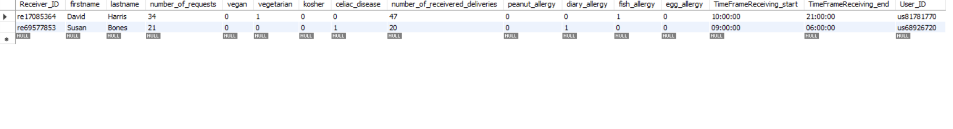
RECEIVER TABLE
create table RECEIVER(Receiver_ID varchar(10) NOT NULL, firstname varchar(15) NOT NULL, lastname varchar(15) NOT NULL, number_of_requests INTEGER NOT NULL, vegan BOOLEAN NOT NULL, vegetarian BOOLEAN NOT NULL, kosher BOOLEAN NOT NULL, celiac_disease BOOLEAN NOT NULL, number_of_receivered_deliveries INTEGER NOT NULL, peanut_allergy BOOLEAN NOT NULL, diary_allergy BOOLEAN NOT NULL, fish_allergy BOOLEAN NOT NULL, egg_allergy BOOLEAN NOT NULL, TimeFrameReceiving_start TIME NOT NULL, TimeFrameReceiving_end TIME NOT NULL, User_ID varchar(10) NOT NULL); ALTER TABLE RECEIVER ADD CONSTRAINT PK_RECEIVER PRIMARY KEY (Receiver_id); ALTER TABLE RECEIVER ADD CONSTRAINT fk_RECEIVER FOREIGN KEY (User_ID) REFERENCES USERS(User_ID);

Slide 11
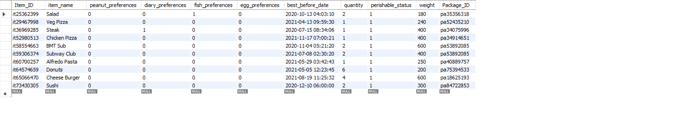
ITEM TABLE
create table ITEM(Item_ID varchar(20) NOT NULL, item_name varchar(25) NOT NULL, peanut_preferences BOOLEAN NOT NULL, diary_preferences BOOLEAN NOT NULL, fish_preferences BOOLEAN NOT NULL, egg_preferences BOOLEAN NOT NULL, best_before_date DATETIME NOT NULL, quantity INTEGER NOT NULL, perishable_status BOOLEAN NOT NULL, weight FLOAT NOT NULL, Package_ID varchar(20) NOT NULL); ALTER TABLE ITEM ADD CONSTRAINT PK_ITEM PRIMARY KEY (Item_id); ALTER TABLE ITEM ADD CONSTRAINT fk_ITEM FOREIGN KEY (Package_ID) REFERENCES PACKAGE(Package_ID);

Slide 12
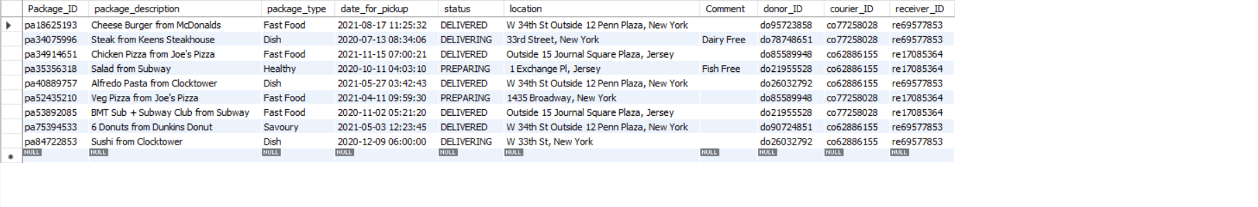
PACKAGE TABLE
create table PACKAGE(Package_ID varchar(20) NOT NULL, package_description varchar(150) NOT NULL, package_type varchar(10) NOT NULL, date_for_pickup DATETIME NOT NULL, status varchar(15) NOT NULL, location varchar(45) NOT NULL, Comment varchar(150), donor_ID varchar(10) NOT NULL, courier_ID varchar(10) NOT NULL, receiver_ID varchar(10) NOT NULL); ALTER TABLE PACKAGE ADD CONSTRAINT PK_PACKAGE PRIMARY KEY (Package_id); ALTER TABLE PACKAGE ADD CONSTRAINT fk_PACKAGE_DONOR FOREIGN KEY (Donor_ID) REFERENCES DONOR(Donor_ID); ALTER TABLE PACKAGE ADD CONSTRAINT fk_PACKAGE_COURIER FOREIGN KEY (Courier_ID) REFERENCES COURIER(Courier_ID); ALTER TABLE PACKAGE ADD CONSTRAINT fk_PACKAGE_RECEIVER FOREIGN KEY (Receiver_ID) REFERENCES RECEIVER(Receiver_ID);

Slide 13
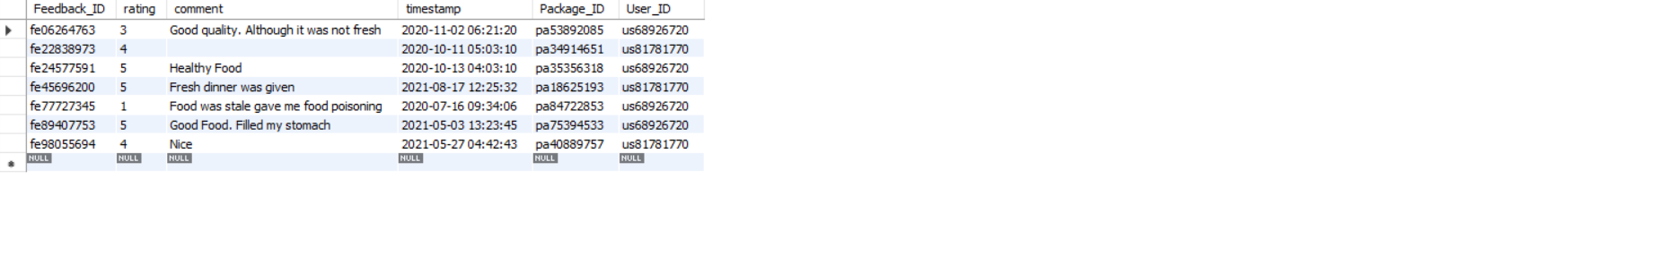
FEEDBACK TABLE
create table FEEDBACK(Feedback_ID varchar(10) NOT NULL, rating INTEGER NOT NULL, comment varchar(150), timestamp DATETIME NOT NULL, Package_ID varchar(20) NOT NULL, User_ID varchar(10) NOT NULL); ALTER TABLE FEEDBACK ADD CONSTRAINT PK_FEEDBACK PRIMARY KEY (Feedback_id); ALTER TABLE FEEDBACK ADD CONSTRAINT fk_FEEDBACK FOREIGN KEY (User_ID) REFERENCES USERS(User_ID);

